Slide 1

Protocol
AGI

Slide 2










Introduction
How it will be if an amputee can get a new arm and he could use that arm as other normal people do? If it happens, then definitely it can lead to a new life style. It can be possible if mental causation is true. So we explored many researches and come to know that one way of achieving mental causation is through Neuroprosthetics. An electrode will be implanted on brain which can help in trapping the brain signal. We will be using Neuroprosthetic device to decode the signal from the electrode and encode the signal from the arm. Our experiment is mainly on these signals where identifying the correct meaning of the signals from the brain and outputting the best possible action for the present situation with consideration of the brain signal.

Slide 3

Methodology
Process
Sampling

Slide 4

Process
We are using reinforcement learning and kmeans techniques to implement the scenario.
Reinforcement Learning has used to improve the working policy based on feedback, which can help in learning the new actions or modify the action which can lead to best output results.
Kmeans has used to find the way for learning. Initially there will be some clusters formed based on training data(note: data points in each cluster is representing the actions). If new action (new action is found based on the signal from Neuroprosthetic device) is needed to take then we mix this new action with the previous clusters and say that whole dataset of actions as D. Then we apply Kmeans on D which leads to formation of new clusters. Later we will collect all the actions which comes into the same cluster into which new action comes. Then we do the improvised action of those actions.
If again any action arrives we will repeat the same process to find the best doable action for current situation, thus upon taking many actions number of clusters also increases because of boundary expansion.
Boundary Expansion can be done in two situations as follows
When Number of clusters decreases
When Number of clusters increases

Slide 5

Boundary Expansion
When no of clusters decreases
no of clusters decreases if new action is similar to actions in two clusters, those the new action causes to merge the two cluster as a single one
No of clusters increases if the boundary points of cluster are similar to new action . Then the new action itself forms new cluster with boundary points.
When no of clusters increases

Slide 6
Reinforcement Learning
Implemented using DDPG(Deep Deterministic Policy Gradient) where we have Actor-Critic Network(input is current state and output is the action) to get best suitable action for the current state.
We store all information of present state in memory including the action need to be taken next.
After fixed iterations(commonly said as batch size), we update the policy of the agent i.e., the weights of the Actor-Critic Network are updated based on Gradient policy which can be treated as feedback.
Thus learning through feedback is achieved through reinforcement Learning.
Feedback is needed as it can correct the past errors and also improvises the past output.
Thus to we are choosing Reinforcement Learning with feedback protocol

Slide 7
Steps to conduct the experiment without feedback
First we have to create clusters based on training data using Kmeans algorithm.
Then take random actions (since no feedback), observe the rewards for each step and store those rewards separately.
An episode consists of taking some constant number of steps.
In episode, Restart the agent and take specified steps.
Store the total reward of each episode in a separate data structure and plot the graph with that data to observe the pattern of curve.

Slide 8
Steps to conduct the experiment with feedback
With feedback means Agent will have the memory of past experiences. Thus reinforcement Learning concept can help in implanting feedback.
First we have to create clusters based on training data using Kmeans algorithm.
Also create DDPG Agent who can update his policy based on feedback.
An episode consists of taking some constant number of steps.
In episode, Restart the agent and take specified steps.
In each step of episode, we pass current state to agent and gets the corresponding action in return from the agent.
Implement that action on environment and get reward.
Store the reward of each episode in a separate data structure and plot the graph with that data to observe the pattern of curve.

Slide 9
Reward Criteria
Reward is distributed for the action based on following criteria:-
We are giving reward after applying Kmeans on the D(discussed in fourth slide) based on output of the Kmeans
First of all, we apply Kmeans on D. Then find the cluster which has the new data point and get the similarity among the data points of that cluster and call that similarity as S.
If S<=0.005 then reward = 1
Else If 0.005<S<=0.05 then reward = S*5
Else reward = 0

Slide 10
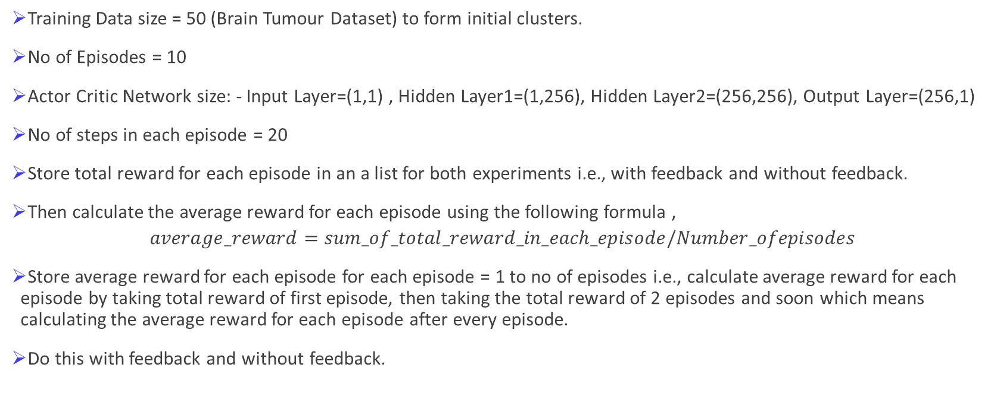
Sampling
Training Data size = 50 (Brain Tumour Dataset) to form initial clusters.
No of Episodes = 10
Actor Critic Network size: - Input Layer=(1,1) , Hidden Layer1=(1,256), Hidden Layer2=(256,256), Output Layer=(256,1)
No of steps in each episode = 20
Store total reward for each episode in an a list for both experiments i.e., with feedback and without feedback.
Then calculate the average reward for each episode using the following formula ,
$$average_reward=sum_of_total_reward_in_each_episode/Number_ofepisodes$$
Store average reward for each episode for each episode = 1 to no of episodes i.e., calculate average reward for each episode by taking total reward of first episode, then taking the total reward of 2 episodes and soon which means calculating the average reward for each episode after every episode.
Do this with feedback and without feedback.

Slide 11
Average Rewards per episode Flow chart

Slide 12
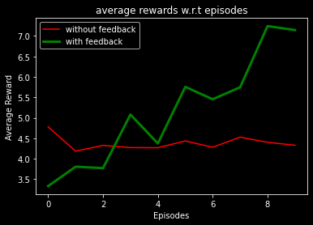
Results
Plot the average reward for episode vs episode curve for both with and without feedback in one graph itself to observe the differences.
While plotting give different colours, line widths to two curves and also add legend to the plot to differentiate the curves.
In the following graph Green curve represents the average reward for each episode with feedback (increasing with episodes) where as red curve is without feed back which is non increasing function.
Thus from the output of experiment, we can conclude that having feedback can let us to go through an optimized or best way.

Slide 13

Flow chart of Whole process

Slide 14
Thus having agent who updates based feedback can let the robotic arm to take the best action than without feedback w.r.t reward.
Reward is given by the Environment, good reward means functioning well according to environment which means adapting to environment.
So with feedback learning process speeds up and model adapts to environment early than without feedback.
Also there is no guarantee that model can explore whole environment if it don’t have feedback since random actions are taken if there is no feedback

Slide 15
Feedback Protocol Criteria
Must be a learning model.
Action need to be dependent on at least one parameter.
Action space should be upper bounded by maximum value in observation space.
Need to have the correct number of dimensions in vector while representing Actions, States.
Need to specify the Observation space(Continuous) ,Action space(continuous).
Need to call memory method after every iteration to store all the parameters of that instance into the memory
Must have flag variable which stores the number of iterations, after batch size number of iterations must call the update method so that agent can update his policy through feedback.

Slide 16
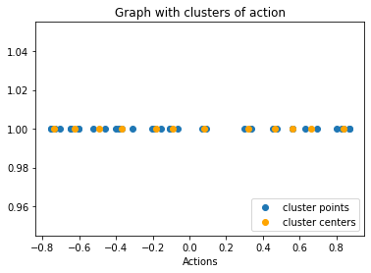
Without feedback Example
Training Data : - Brain Tumor Data
Training Data after preprocessing :-
[-0.46243523640094003, -0.3841752075458228, 0.4569895514263396, -0.31184197799102814, 0.6326453442485581, 0.09294541964224708, 0.5624190891509335, 0.6927317514581823, -0.6060161615446631, -0.20323865362323623, -0.15464530453121192, -0.731881191675252, -0.7558254578516869, -0.6447539682682812, -0.7558254578516869, -0.4019470190100394, -0.7072650559530831, -0.36812318324775295, 0.8001358387870361, 0.3307553251967342, 0.29973476575610447, -0.06520896086950452, 0.8261295165970591, 0.8716239137746449, -0.10458603102431457, 0.06893190082489792, 0.3375711240860007, 0.8408416546280005, -0.6447539682682812, 0.5623417721824796, -0.6060161615446631, -0.10458603102431457, -0.5241046814507794, 0.870788180067988, -0.1868640393933036, 0.47750860124264016]
Note: - Action taken here are chosen randomly as there is no feedback.
Clusters formed after Kmeans on training data are as follows:-
Current State = [0.14128861]

Slide 17
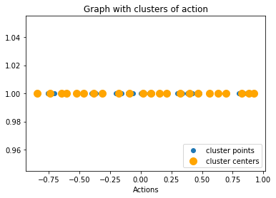
Episode1
Actions taken : -
[0.2030358183719061, 0.8813152763610992, 0.6987852741386176, 0.3785782595884388, -0.17977155727138316, 0.9214886974902643, 0.8814795253689662, 0.32710599001904006, -0.8469756991445403, 0.15218430043323705, 0.0006509610874256833, 0.032428328381401084, 0.15756079755366148, -0.6065725913885862, 0.2159934681786002, 0.4191066140049087, 0.8936239018922079, -0.470147628092336, 0.9284551085323896, 0.08306629414467226]
Reward :- 4.46
average _reward:- 4.464492
Current State : - [0.07946388]

Slide 18
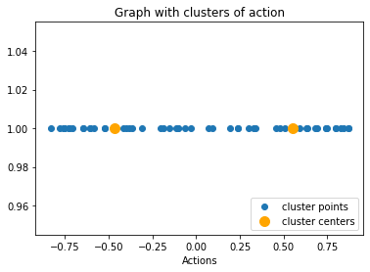
Episode2
Actions taken : -
[-0.03195901774373566, 0.6359945658245036, 0.5082509642272159, -0.41560242079536436, 0.7458975826118339, -0.832578141877049, 0.6836652115308697, -0.7250563093151958, 0.5907829633789188, -0.7796630043333062, -0.7524883480490383, -0.1162846625077083, 0.7452117083504861, -0.5859901689754097, 0.7986767290773373, 0.19123545111164675, 0.2397065185770504, 0.23864797015559014, -0.5244101819045959, 0.7425439343794584]
Reward :- 3.12
average _reward:- 3.79455875
Current State : - [0.37437906]

Slide 19
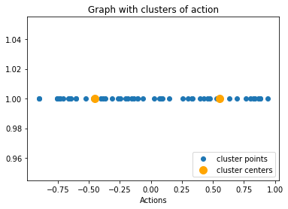
Episode3
Actions taken : -
[0.7655060112157912, -0.6673172895079673, -0.9029727554031055, 0.8743676665427484, 0.39659244696410223, 0.07917759591291995, 0.8796642282685077, -0.9002299853084659, -0.6589128851749544, -0.26165482275952234, 0.14871846544034217, -0.24361933345222075, -0.13475968629154544, 0.25756224676340644, 0.4241276024972007, 0.029484829433884086, -0.7367556192019029, 0.9425127926033878, 0.8821665433872234, 0.5302514454365252]
Reward :- 4.01
average _reward:- 3.865231333333334
Current State : - [0.77567238]

Slide 20
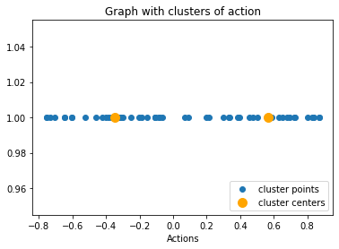
Episode4
Actions taken : -
[-0.3259850715087582, -0.10850050997146776, 0.5888418970676128, 0.7267933842192404, 0.6514476174849202, 0.3934071720499941, 0.5032602808494024, -0.4240172281444168, -0.08212380145443365, -0.32577351438025337, -0.2532334387895214, 0.6811486339959723, 0.19962763724260535, 0.7208855611417915, -0.3162158730450373, -0.2977179901747504, 0.21558940706296426, -0.3584467959326183, 0.38626825029128575, -0.08407090381990656]
Reward :- 6.39
average _reward:- 4.49597925
Current State : - [0.94745394]

Slide 21
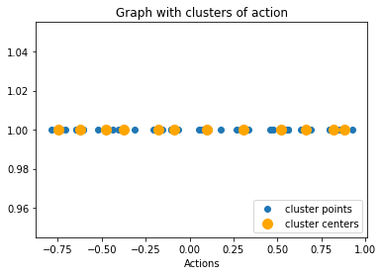
Episode5
Actions taken : -
[0.8400656961075708, -0.10334350643666812, -0.439396146407252, -0.623351604057053, 0.860079702150377, 0.5456218625257185, -0.16225787314235163, 0.28776406300742297, -0.40268601841593954, 0.9276865074245431, -0.47731505729417645, -0.7884927868124367, -0.06911531540318139, 0.05520160407357366, 0.17848134004999383, 0.7983478980812617, 0.10880979205434316, -0.06773199979622113, 0.6607438135914945, 0.26806323111248465]
Reward :- 2.57
average _reward:- 4.110132200000001
Current State : - [0.25490806]

Slide 22
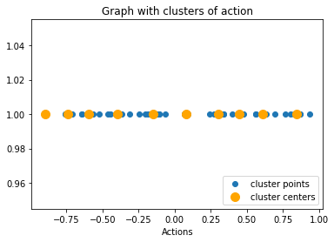
Episode6
Actions taken : -
[0.7675077469975715, 0.2430277488010426, -0.15504333233777579, -0.561798716264791, -0.5877737536154051, 0.2725585657551013, -0.44424315660182434, 0.07101082067810105, 0.4718734879520943, -0.8976738166528058, 0.4555762585911374, 0.9355946718873336, 0.0820262878136715, 0.4364994927382897, 0.40132332687371974, -0.7302326729326374, -0.12138243506805857, -0.4101243998752484, -0.24238637347366487, 0.3394951135205986]
Reward :- 1.67
average _reward:- 3.7038238333333333
Current State : - [0.82513648]

Slide 23
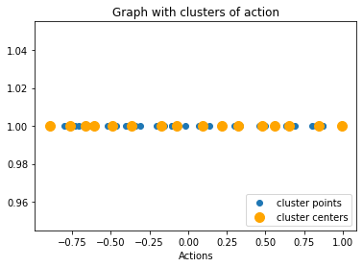
Episode7
Actions taken : -
[-0.38388260717117983, -0.8956877481869843, -0.3381195831264523, 0.13508533030454983, -0.018749879938030123, 0.866524432775936, 0.9941804116969104, 0.2167491539374038, -0.07696097886746012, -0.6600106486364281, -0.7992477963782048, -0.1597568430650005, 0.32630986747969004, 0.08725319039057466, -0.1677535771455092, -0.4866722341014773, -0.6085223450393669, 0.4947687272545038, 0.632362797841727, 0.09541392111994695]
Reward :- 2.51
average _reward:- 3.5334022142857147
Current State : - [0.21040023]

Slide 24
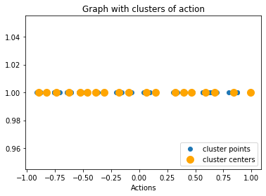
Episode8
Actions taken : -
[-0.9157860762258001, -0.7386484297765024, -0.8328499912832179, 0.6161212098305873, -0.8903516682737145, -0.7540676991981179, 0.4059587413621697, 0.14984610037897217, 0.14718983085228987, -0.3097647026502468, -0.46357479547528824, 0.9916449370235576, 0.38992036098656135, -0.8208979688765605, -0.8781014555398508, 0.6534037195004092, 0.03891544786916734, -0.5403466794901053, -0.5060633490922792, -0.5345498546601481]
Reward :- 7.18
average _reward:- 3.9892000625
Current State : - [0.24122282]

Slide 25
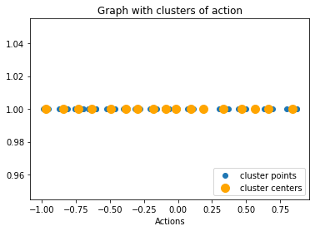
Episode9
Actions taken : -
[0.36866715793901594, 0.11446615389302317, -0.2923181404546211, 0.4998408400138237, -0.2818830627862323, -0.6557781842504791, -0.9543817718333933, -0.0023886566616602156, -0.752297283104669, 0.849163690555242, 0.563740273651893, -0.9912516945075276, 0.44127778241103366, -0.8722701404100637, 0.1883027260667094, -0.810225716210967, -0.6547131256279941, -0.025642786323714084, -0.3145083183538746, -0.6978475534448774]
Reward :- 5.01
average _reward:- 4.103092333333333
Current State : - [0.58578931]

Slide 26
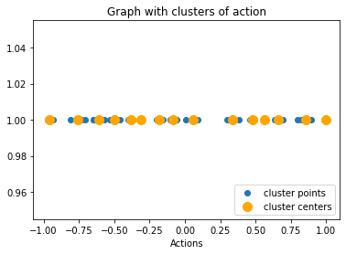
Episode10
Actions taken : -
[-0.06122722159456151, -0.5675505170379267, -0.5981612705002071, -0.3090914609762856, 0.4917463270143607, -0.48550821683957235, -0.973745509931794, 0.8810597493935863, 0.38023175212819593, -0.934289877689976, 0.8931799271143508, -0.9656859843018377, -0.806785122760052, -0.5321547166122078, -0.7734164838921647, 0.4832666819220224, 0.648276589818485, 0.9980871548154431, -0.502097787850565, 0.008049734267206565]
Reward :- 3.5
average _reward:- 4.0430839999999995
Current State : - [-2.14002694]

Slide 27
With Feedback Example
Training Data : - Brain Tumor Data
Training Data after preprocessing :-
[-0.46243523640094003, -0.3841752075458228, 0.4569895514263396, -0.31184197799102814, 0.6326453442485581, 0.09294541964224708, 0.5624190891509335, 0.6927317514581823, -0.6060161615446631, -0.20323865362323623, -0.15464530453121192, -0.731881191675252, -0.7558254578516869, -0.6447539682682812, -0.7558254578516869, -0.4019470190100394, -0.7072650559530831, -0.36812318324775295, 0.8001358387870361, 0.3307553251967342, 0.29973476575610447, -0.06520896086950452, 0.8261295165970591, 0.8716239137746449, -0.10458603102431457, 0.06893190082489792, 0.3375711240860007, 0.8408416546280005, -0.6447539682682812, 0.5623417721824796, -0.6060161615446631, -0.10458603102431457, -0.5241046814507794, 0.870788180067988, -0.1868640393933036, 0.47750860124264016]
Note: - Action taken here are chosen by Agent based on feedback
Clusters formed after Kmeans on training data are as follows:-
Current State = [0.40789687]

Slide 28
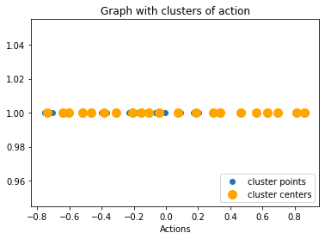
Episode1
Actions taken : -
[0.29170453260806833, -0.008101485133521269, 0.07872128591293912, 0.2035133366754175, -0.23015085956361414, -0.5171771759924498, -0.39345006406364547, -0.042829381705625835, -0.03481418915773646, 0.29779186550216896, -0.3107752747292495, 0.16904546279959975, -0.471280304063729, -0.4590686719471727, 0.06864819814322065, -0.06222821468897788, -0.1620075691941912, -0.14190901616488055, -0.37824286795613327, -0.6373639932869258]
Reward :- 7.06
average _reward:- 7.0590090000000005
Current State : - [0.51877472]

Slide 29
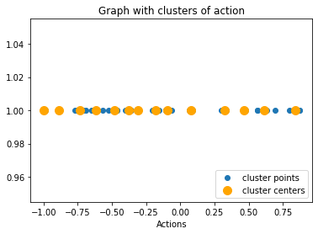
Episode2
Actions taken : -
[-0.6149413298902117, -0.7721804381328234, -0.985428856890963, -1.0, -0.5671427906217124, -0.36017288547449366, -0.6289773696883656, -0.4627466986028146, -0.6918333157333632, -0.7342707537781832, -1.0, -1.0, -1.0, -1.0, -1.0, -1.0, -1.0, -0.8899782904090549, -1.0, -1.0]
Reward :- 9.65
average _reward:- 8.35332525
Current State : - [0.63559]

Slide 30
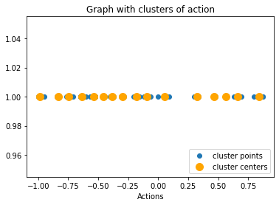
Episode3
Actions taken : -
[-0.8417206839010499, -0.6454087357669803, -0.8248870913514352, -0.6470911476542991, -0.5317379393788526, -0.7637637201633487, -0.7467188423759668, -0.11909183770619547, -0.5251976882371205, -0.07508685189036646, -0.2821912471885586, -0.0016685043872244343, -0.08593789987989298, -0.5650481672404657, -0.5249768361163613, -0.9516858263973726, -0.4461958842555891, -0.552422041089087, -1.0, -1.0]
Reward :- 5.02
average _reward:- 7.242815
Current State : - [0.17703581]

Slide 31
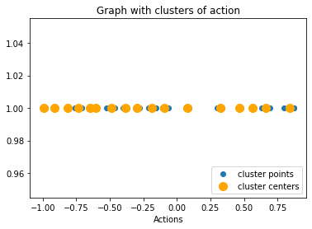
Episode4
Actions taken : -
[-0.5998854725803203, -0.9983964002072503, -0.9179897557709076, -0.6528707909741498, -0.6545814721417835, -0.9034213243272052, -0.7315920330180219, -0.27663750035693946, -0.2096887603414903, -0.4724595494664199, -0.8151134176078672, -1.0, -1.0, -0.9896486240319219, -0.979811509821505, -1.0, -1.0, -1.0, -1.0, -0.9801561506947283]
Reward :- 11.68
average _reward:- 8.352832625000001
Current State : - [0.27261013]

Slide 32
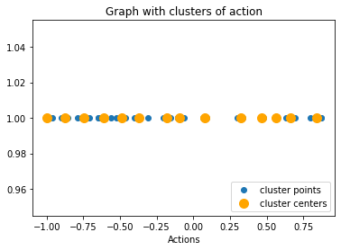
Episode5
Actions taken : -
[-0.8615400960956197, -1.0, -1.0, -1.0, -1.0, -0.7886629186520635, -1.0, -1.0, -1.0, -0.5637973331296255, -0.37374490122792836, -0.4780624078021708, -0.8586970398396857, -0.9595455146015233, -1.0, -1.0, -1.0, -1.0, -0.8969679890721264, -1.0]
Reward :- 13.4
average _reward:- 9.3625085
Current State : - [0.09893745]

Slide 33
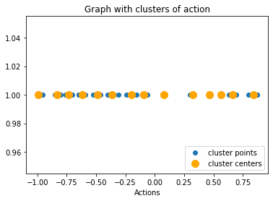
Episode6
Actions taken : -
[-0.742348229154586, -0.8372389451231811, -0.9539658854682401, -1.0, -1.0, -1.0, -0.8511806524136589, -0.48552542321397985, -0.5918530449143368, -0.3471907122662229, -0.740594963190567, -1.0, -1.0, -1.0, -1.0, -0.8006763756275344, -0.2435014682577492, -0.703001195080029, -0.47931237617677325, -0.7313675853716841]
Reward :- 4.14
average _reward:- 8.4915075
Current State : - [0.02739357]

Slide 34
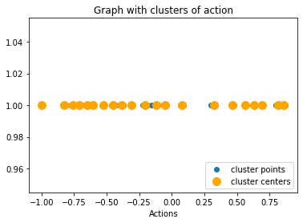
Episode7
Actions taken : -
[-1.0, -1.0, -1.0, -1.0, -0.8101887038343702, -0.6525181660339922, -0.8409730094393151, -0.6520623086979098, -0.6902185078645425, -0.7070461010312907, -0.368773022701846, -0.4347224782576298, -0.8278141847888361, -0.770291537326126, -0.5256942397513927, -1.0, -1.0, -0.7604943966841038, -0.22620842389474694, -0.03640596856531564]
Reward :- 8.74
average _reward:- 8.526770571428573
Current State : - [0.28441473]

Slide 35
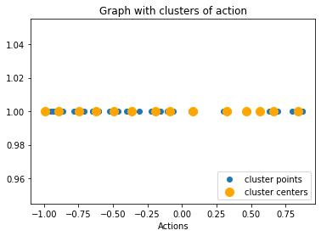
Episode8
Actions taken :-
[-0.9704695810293498, -0.9490390812796611, -1.0, -0.902746464444401, -1.0, -0.7802482792419423, -0.9304221015885314, -1.0, -1.0, -1.0, -1.0, -1.0, -1.0, -0.8740799472684986, -0.7326025608043821, -0.6181938230447337, -0.8624106928805415, -0.0871930508659009, -0.22613337834021463, -0.07594297279178686]
Reward :- 5.09
average _reward:- 8.0967213125
Current State : - [0.11386765]

Slide 36
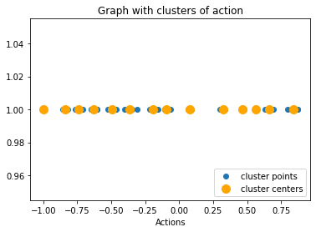
Episode9
Actions taken :-
[-0.8435466826214763, -0.8201060083675404, -0.9972559382139525, -0.8536075525217762, -0.6289644470782572, -0.344359342662913, -0.21551949749137655, -0.49994379145326495, -0.761560721332233, -1.0, -1.0, -1.0, -1.0, -1.0, -1.0, -1.0, -1.0, -1.0, -1.0, -1.0]
Reward :- 12.58
average _reward:- 8.594443277777778
Current State : - [0.34198284]

Slide 37
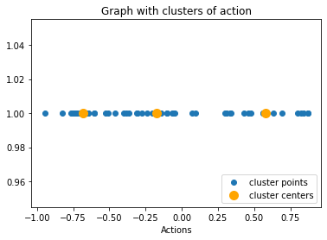
Episode10
Actions taken :-
[-0.7220319047568212, -0.6533336960839444, -0.8234574593715933, -0.9469457016973761, -0.6947476376639076, -0.7405226985182891, -0.30336650674021315, -0.06357312827879424, -0.14477249351201216, -0.275450995004186, -0.049226672126286175, -0.6522160076049303, -0.7678910111164743, -0.5115993133093972, -0.6852656014645849, -0.2419119705966769, -0.6710872045763114, -0.14348745506801808, 0.30784799513738337, 0.42812193971992984]
Reward :- 5.21
average _reward:- 8.256171149999998
Current State : - [-8.01293468]

Slide 38
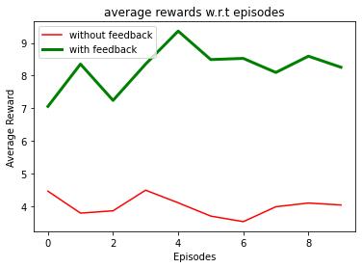
Graph between average rewards for each episode With and without feedback

Slide 39
Conclusion
Thus model with feedback protocol is showing the best learning curve than the model without feedback protocol.
From the above plot, we can see that average_rewards_per_episode is more in feedback protocol.
So finally we can conclude that our model is more efficient with feedback protocol.

Slide 40

Thank You!

